Slide 1
Microservices and DevOps
DevOps and Container Technology
Build Pipelines
Henrik Bærbak Christensen

Slide 2
Pipeline
Deployment Pipeline: An automated implementation of your application’s build, deploy, test, and release process.
Every change that is made in any artefacts of the application triggers the creation of a new instance of the pipeline.
Series of tests, each more demanding, each giving confidence in that it will work. Passing all tests means ready for release.
Humble et al.
Notes:
[Jez Humble, Continuous Delivery, Chapter 1]

Slide 3
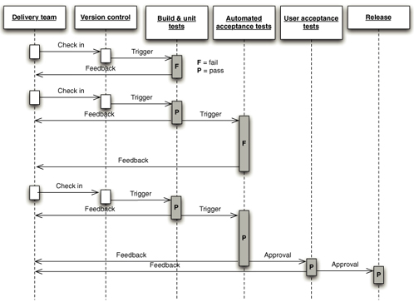
Pipeline
Newman (as usual) waves his hand a bit…
To have different stages in your build, creating what is known as a build pipeline [p 107]
Fast test followed by slow tests
Why run the slow ones if the fast tests fail?
Pattern: Fail fast
Will return to this figure later…
Notes:
Newman p 107

Slide 4
Pipeline
Pipeline = stages of build, test, deploy, and release
Modern build tools have aspects of this
Gradle ‘jar’ = compile, test, build deployment unit
The pipeline is predefined by gradle
And – you could easily handcode (parts) of it!
A bash script that does gradle jar, docker build, docker push
Of course, better with good tool support

Slide 5
Tech Choice?
Lots of Build servers out there
Jenkins, Hudsun, GoCD, Bamboo, Concourse, ...
Git and Bitbucket have their own system
Rather well integrated with the SCM system!!!
Had a lot of issues with Concourse and Jenkins about checking out of a private repo...
Bitbucket in MSDO because...
History – I started there…
TestContainers work well within BitBucket !
You are free to pick any you like...
But I can help more if you choose BitBucket ☺

Slide 6
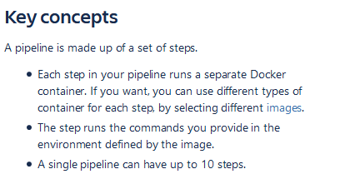
Key Concepts
Infrastructure-as-code bitbucket-pipelines.yml
(YAML format of course)
https://support.atlassian.com/bitbucket-cloud/docs/get-started-with-bitbucket-pipelines/
Notes:
From Bitbucket docs

Slide 7
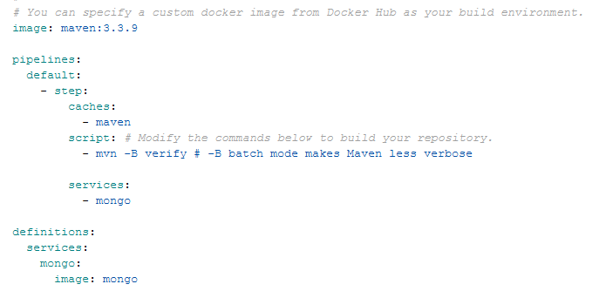
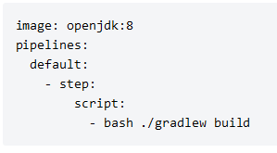
Example Pipeline
From Bitbucket sample code
https://bitbucket.org/bitbucketpipelines/pipelines-guide-java/src/master/bitbucket-pipelines.yml

Slide 8
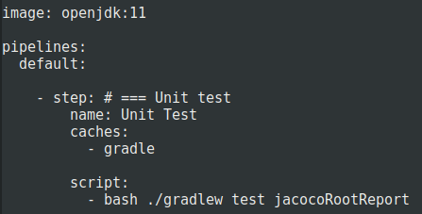
Strong Hint for SkyCave
Potential first step in solution
Huh? Why ‘./gradlew’ ???

Slide 9
Caches
From buttom up is expensive wrt dependencies
Download everything every time ☹
Predefined caches:

Slide 10
Commit Triggered

Slide 11
Pipeline Log

Slide 12
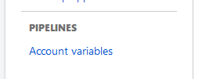
Image Release
… means pushing the built image to Docker hub
… means having the credentials to Docker hub
So you need to store the credentials in BitBucket
Do not have them in the script!!!
And I always spend 15 minutes trying to find the variables ☹

Slide 13
Caveat
Free offer limit is 50 build minutes per month
So…
Keep the pipeline in your ‘deploy’ branch only!
In ‘dev’/’master’ you will run out of build time very soon…
Or – get an ‘academic license’ – I get 500 minutes for free…

Slide 14
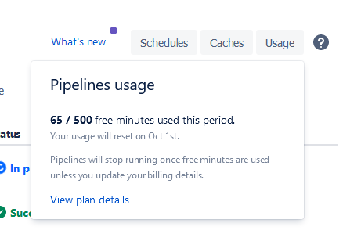
Review Usage

Slide 15
Take Small Steps
Creating your first pipeline has a somewhat steep learning curve…
Tutorial material is, well, ok.
Bit convoluted…
Take small steps
Lots of commits, lots of waiting for pipeline to start, but debugging is not funny

Slide 16
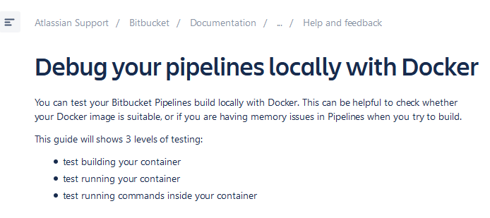
Small Steps
Maybe have a look at (though I have not tried it)

Slide 17
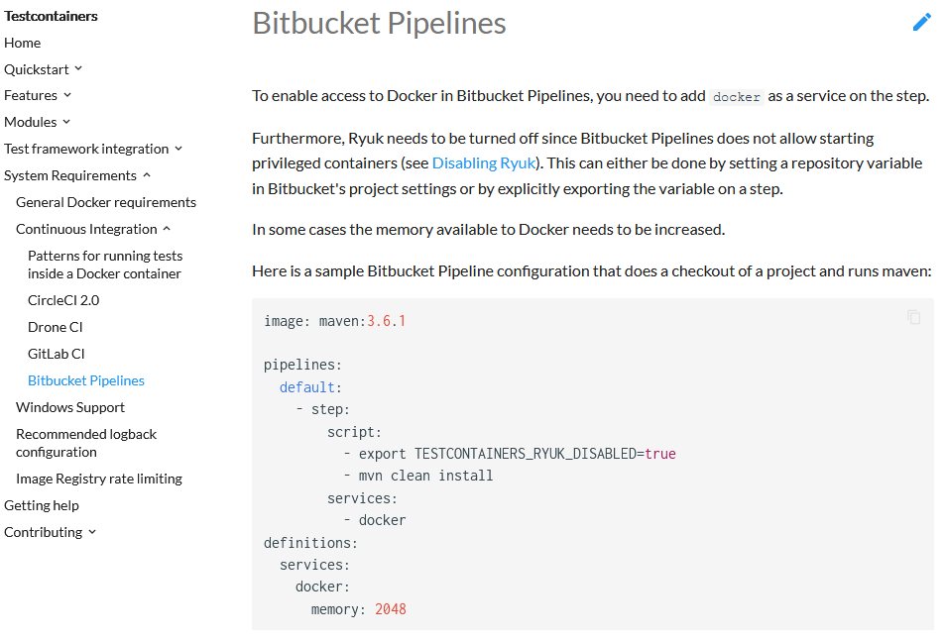
Integration Tests in BitBucket
TestContainers works well in Bitbucket pipelines !
Notes:
https://www.testcontainers.org/supported_docker_environment/continuous_integration/bitbucket_pipelines/

Slide 18
Summary
Deployment Pipeline: An automated implementation of your application’s build, deploy, test, and release process.
Build Pipeline: An automated implementation of your application’s build, deploy, test, and release process.
Uses the Fail fast pattern
Tool supported – triggered by (certain) SCM commits

